Slide 1
Chinese Culture
Food

Slide 2
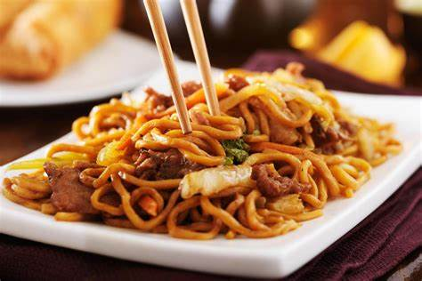
Chinese Food
There are many popular recipes in China
Some of them include Peking Roasted duck, a famous dish which sometimes can be eaten with pancakes; Kung Pao Chicken, a chicken dish popular everywhere, key ingredients include diced chicken, chilli and cucumber.

Slide 3
Dumplings
It goes without saying that Dumplings are famous worldwide.
Dumplings are minced meat or vegetables in dough.
They can be cooked by being boiling, steaming, or frying.
They are traditionaly eaten at new year (in this sense they are a lot like Mince Pies.)

Slide 4
New Year
Chinese New year has many different foods that are eaten.
These include Dumpling; Fish, representing success; Spring rolls, representing wealth and Nian gao, a cake.

Slide 5
Noodles
Noodles are a traditional Chinese recipe
It is a simple and cheap meal that requires little preparation
It predates and inspires Pasta in Italy.

